Slide 1
Hypothesis Testing

Slide 2

What is a Hypothesis?
A hypothesis is a claim
(assumption) about a
population parameter:
population mean
population proportion
Example: The mean monthly cell phone bill of this city is μ = $42
Example: The proportion of adults in this city with cell phones is p = .68

Slide 3
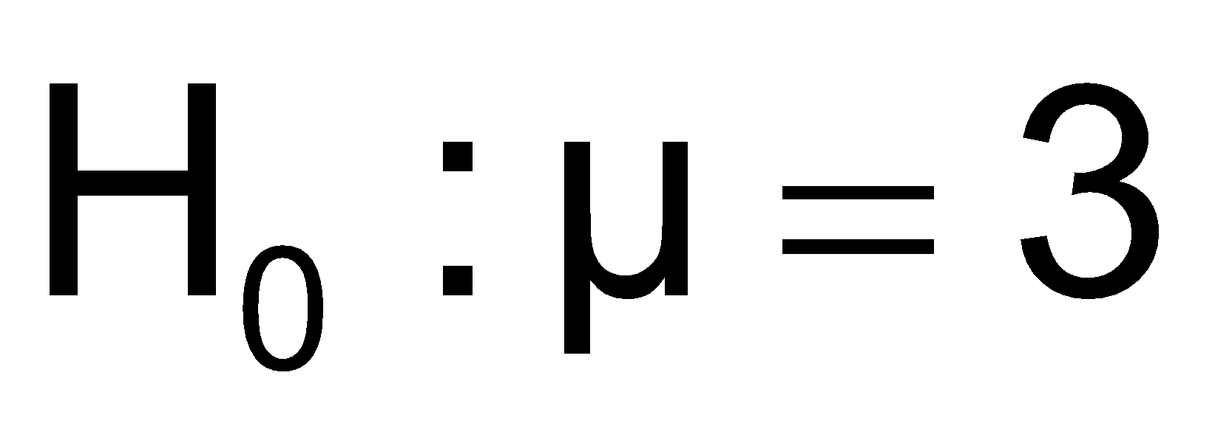

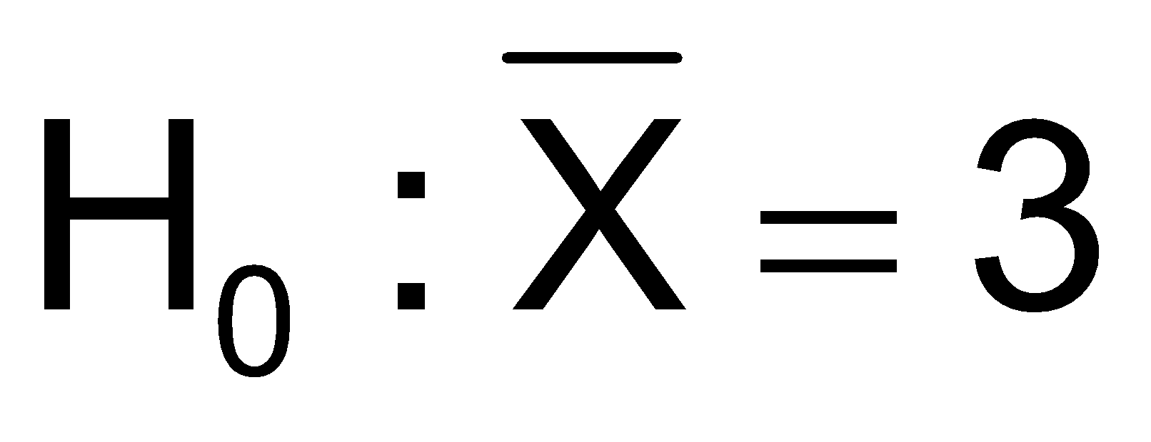
The Null Hypothesis, H₀
States the assumption (numerical) to be tested
Example: The average number of TV sets in U.S. Homes is equal to three ( )
Is always about a population parameter, not about a sample statistic

Slide 4
Hypothesis Testing Process
Claim: the
population
mean age is 50.
(Null Hypothesis:
Population
H₀: μ = 50 )
Now select a random sample
X
Is
=
20
likely if μ = 50?
If not likely,
Suppose
the sample
REJECT
mean age
is 20: X = 20
Sample
Null Hypothesis

Slide 5
Level of Significance, α
Defines the unlikely values of the sample statistic if the null hypothesis is true
Defines rejection region of the sampling distribution
Is designated by α , (level of significance)
Typical values are .01, .05, or .10
Is selected by the researcher at the beginning
Provides the critical value(s) of the test

Slide 6
Outcomes and Probabilities
Possible Hypothesis Test Outcomes
Actual Situation
Decision
H₀ True
H₀ False
Do Not
No error
(1 - )
Type II Error
( β )
Reject
Key:
Outcome
(Probability)
α
H
0
Reject
Type I Error
( )
No Error
( 1 - β )
H
α
0

Slide 7
Hypothesis Tests for the Mean
Hypothesis
Tests for μ
σ Known
σ Unknown

Slide 8
Level of Significance and the Rejection Region
Level of significance =
α
Represents
critical value
H₀: μ = 3 H₁: μ ≠ 3
α
α
/2
/2
Rejection region is shaded
Two-tail test
0
H₀: μ ≤ 3 H₁: μ > 3
α
Upper-tail test
0
H₀: μ ≥ 3 H₁: μ < 3
α
Lower-tail test
0

Slide 9

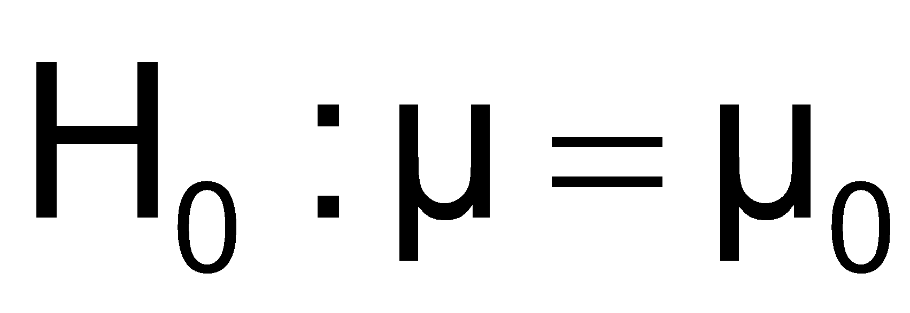
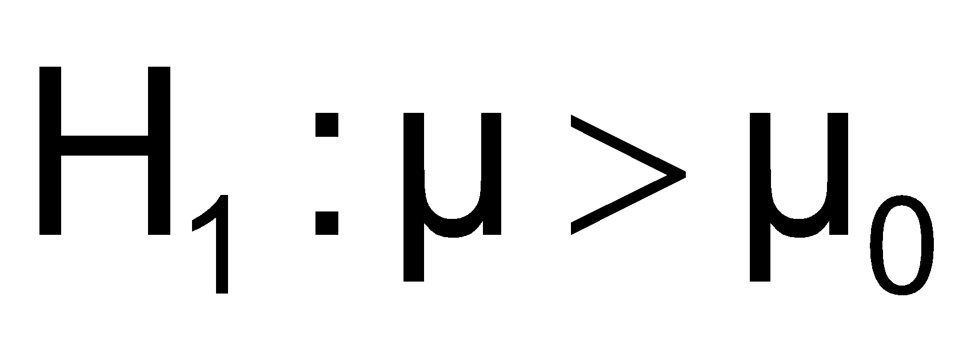
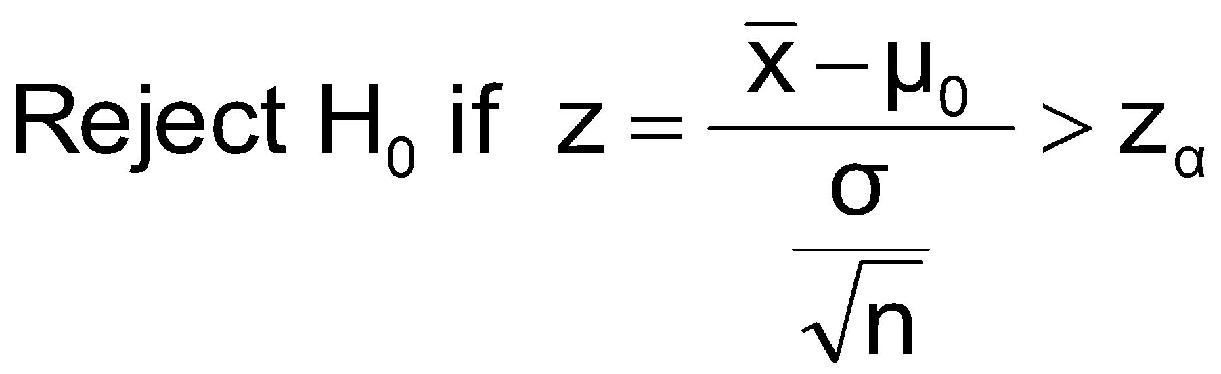
Test of Hypothesis for the Mean (σ Known)
Convert sample result ( ) to a z value
Hypothesis
Tests for μ
σ Known
σ Unknown
Consider the test
The decision rule is:
(Assume the population is normal)

Slide 10


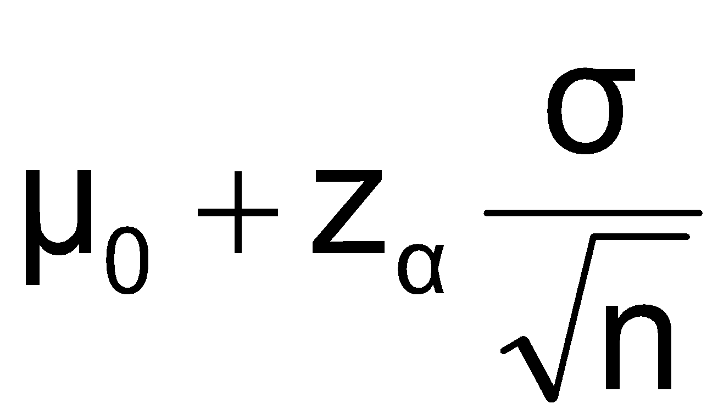
Decision Rule
H₀: μ = μ₀
H₁: μ > μ₀
Alternate rule:
α
Do not reject H₀
Reject H₀
Z
0
z_{α}
μ₀
Critical value

Slide 11
p-Value Approach to Testing
p-value: Probability of obtaining a test statistic more extreme ( ≤ or ≥ ) than the observed sample value given H₀ is true
Also called observed level of significance
Smallest value of α for which H₀ can be rejected

Slide 12
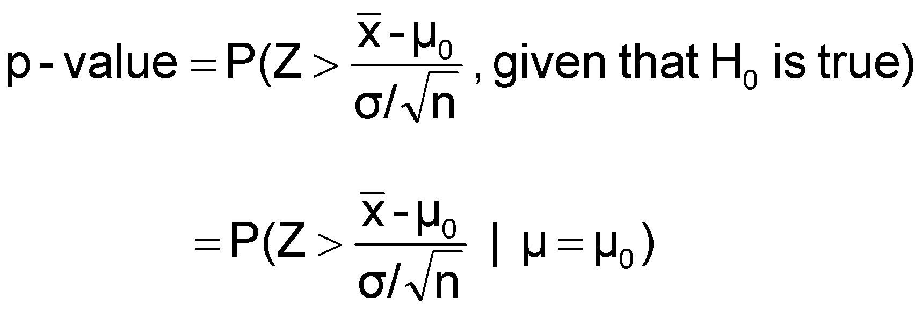
p-Value Approach to Testing
(continued)
Convert sample result (e.g., ) to test statistic (e.g., z statistic )
Obtain the p-value
For an upper
tail test:
Decision rule: compare the p-value to α
If p-value < α , reject H₀
If p-value ≥ α , do not reject H₀

Slide 13
One-Tail Tests
In many cases, the alternative hypothesis focuses on one particular direction
H₀: μ ≤ 3
H₁: μ > 3
This is an upper-tail test since the alternative hypothesis is focused on the upper tail above the mean of 3
This is a lower-tail test since the alternative hypothesis is focused on the lower tail below the mean of 3
H₀: μ ≥ 3
H₁: μ < 3

Slide 14
Two-Tail Tests
In some settings, the alternative hypothesis does not specify a unique direction
H₀: μ = 3 H₁: μ ≠ 3
α/2
α/2
There are two critical values, defining the two regions of rejection
x
3
Reject H₀
Do not reject H₀
Reject H₀
-z_{α/2}
0
+z_{α/2}
z
Lower critical value
Upper
critical value

Slide 15
Example: Upper-Tail Z Test for Mean (σ Known)
A phone industry manager thinks that customer monthly cell phone bill have increased, and now average over $52 per month. The company wishes to test this claim. (Assume σ = 10 is known)
Form hypothesis test:
H₀: μ ≤ 52 the average is not over $52 per month
H₁: μ > 52 the average is greater than $52 per month
(i.e., sufficient evidence exists to support the
manager’s claim)

Slide 16
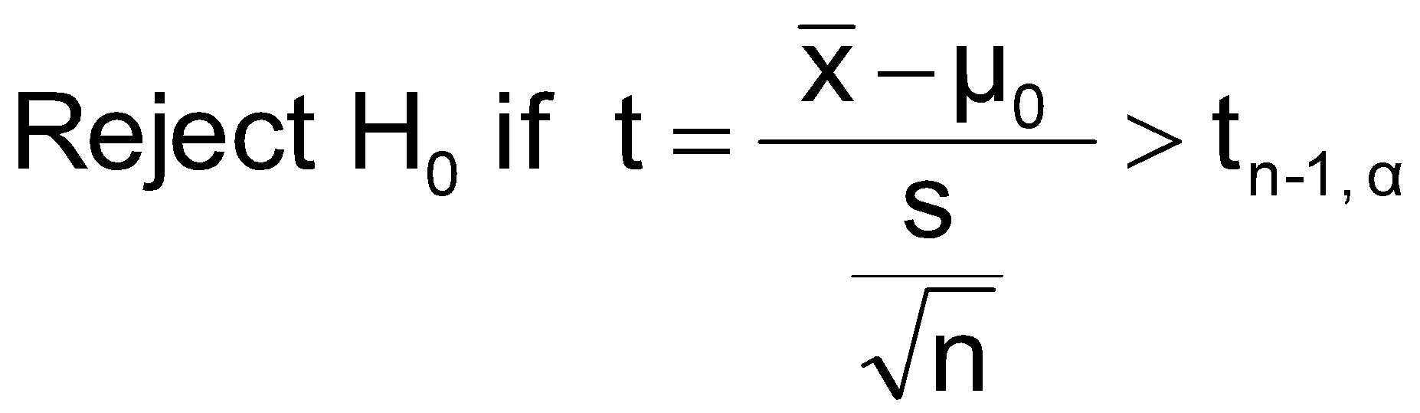
t Test of Hypothesis for the Mean (σ Unknown)
Convert sample result ( ) to a t test statistic
Hypothesis
Tests for μ
σ Known
σ Unknown
Consider the test
The decision rule is:
(Assume the population is normal)

Slide 17
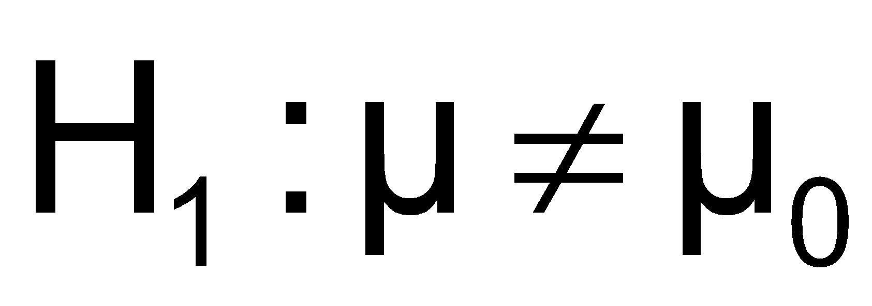
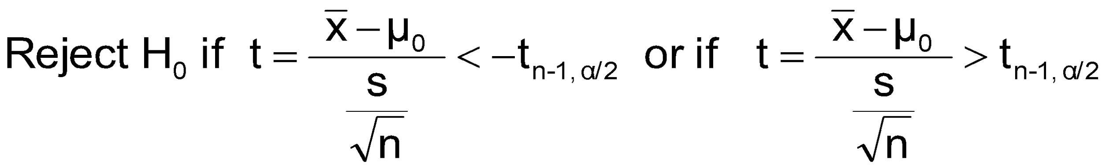
t Test of Hypothesis for the Mean (σ Unknown)
(continued)
For a two-tailed test:
Consider the test
(Assume the population is normal, and the population variance is unknown)
The decision rule is:

Slide 18
Tests of the Population Proportion
Involves categorical variables
Two possible outcomes
“Success” (a certain characteristic is present)
“Failure” (the characteristic is not present)
Fraction or proportion of the population in the “success” category is denoted by P
Assume sample size is large

Slide 19

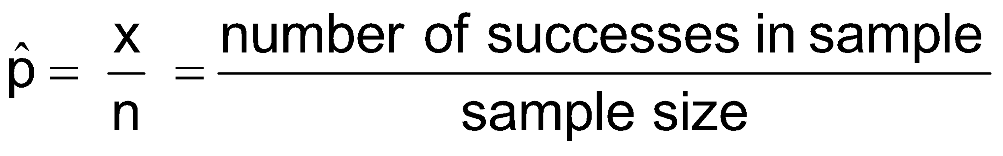

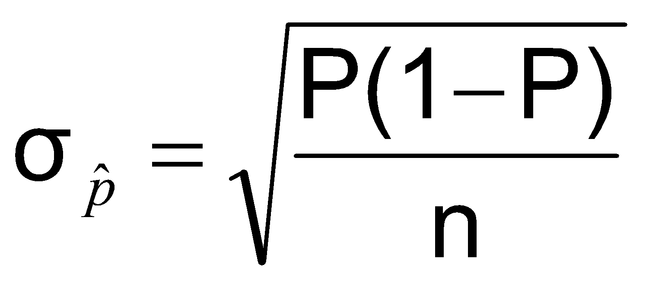
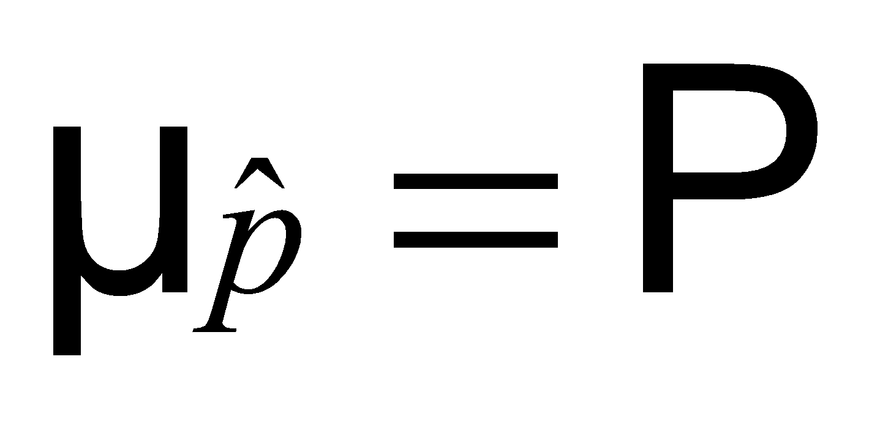
Proportions
(continued)
Sample proportion in the success category is denoted by
When nP(1 – P) > 9, can be approximated by a normal distribution with mean and standard deviation

Slide 20
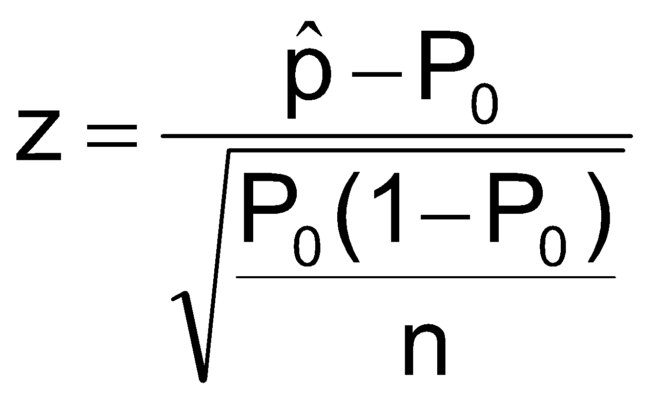
Hypothesis Tests for Proportions
The sampling distribution of is approximately normal, so the test statistic is a z value:
Hypothesis
Tests for P
nP(1 – P) > 9

Slide 21

Example: Two-Tail Test (σ Unknown)
The average cost of a hotel room in New York is said to be $168 per night. A random sample of 25 hotels resulted in x = $172.50 and
s = $15.40. Test at the
α = 0.05 level.
(Assume the population distribution is normal)
H₀: μ = 168 H₁: μ ≠ 168

